Slide 1
Edge Detection Workflow
Parallel Parts
3rd party
decoder
Input Image
RGB Images
Conversion
(Grayscale)
Grayscale Images
Edge Detection
Edge Matrix
3rd party
encoder
Output Edge Image
RGB Edge Images
Conversion
(RGB)
Edge Gray Image
Grayscale Stretch

Slide 2
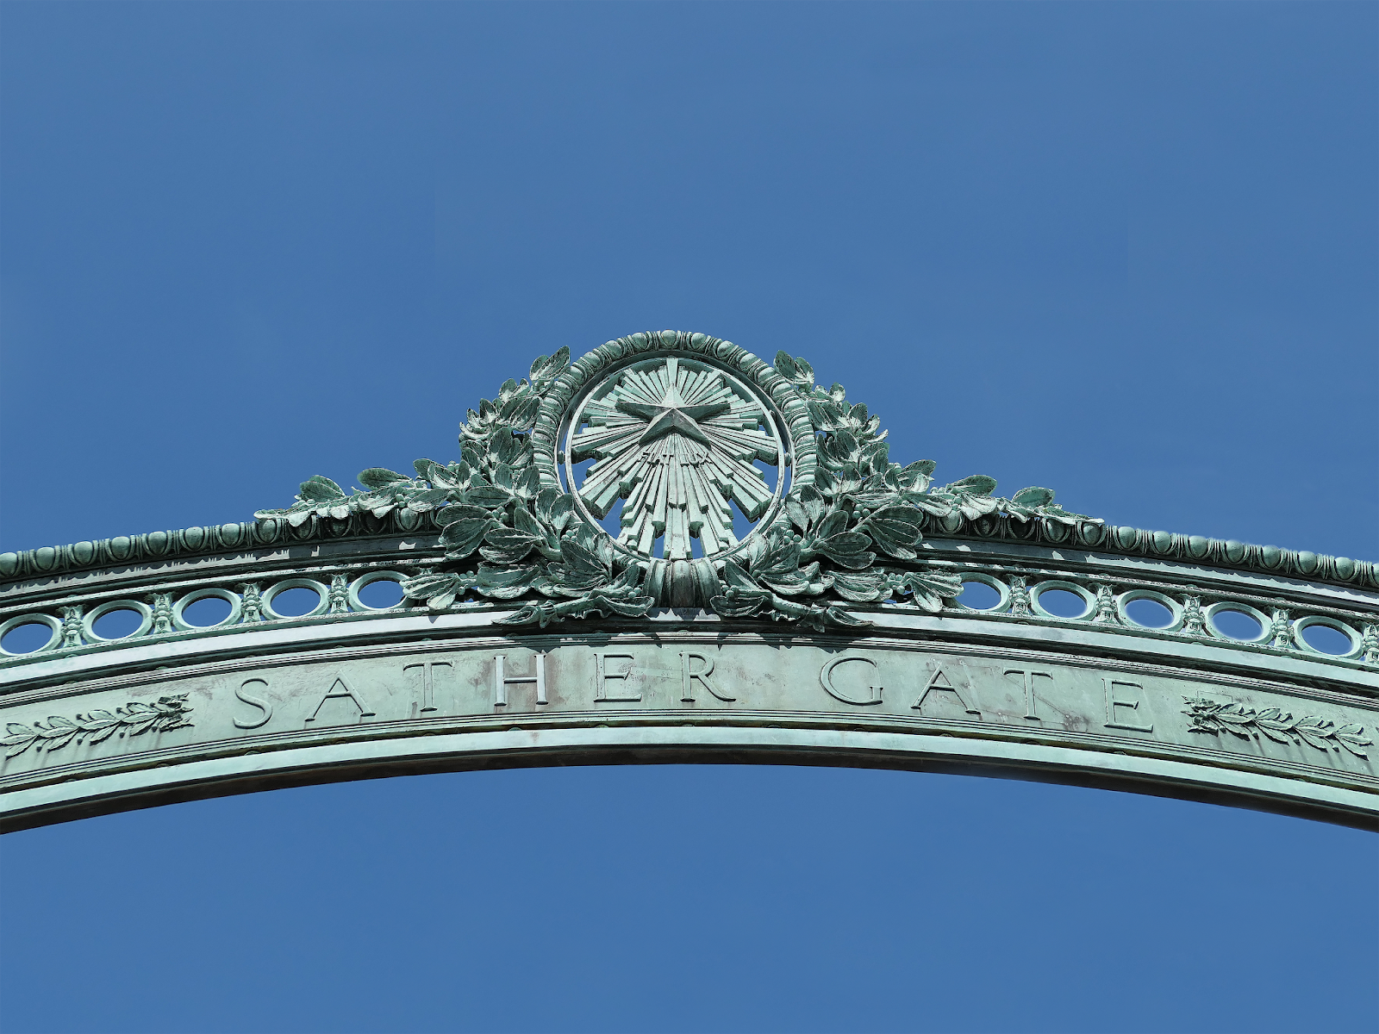
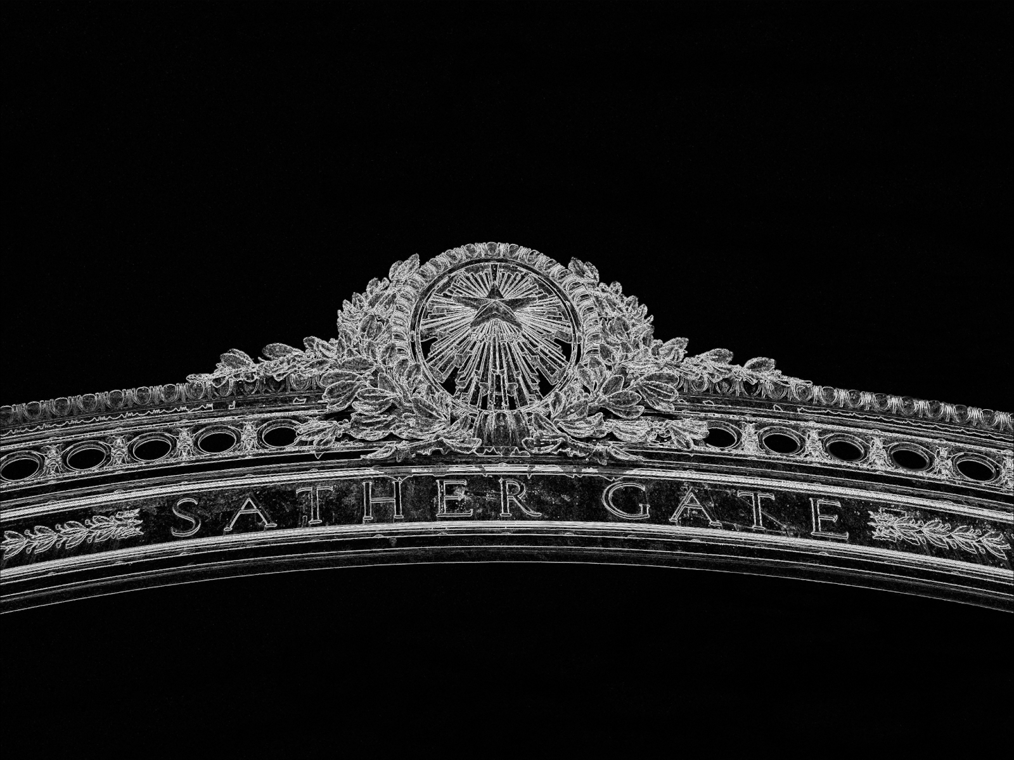
Parallel Parts
3rd party
decoder
RGB Images
Conversion
(Grayscale)
Grayscale Images
Edge Detection
Input Image
Edge Matrix
3rd party
encoder
RGB Edge Images
Conversion
(RGB)
Edge Gray Image
Grayscale Stretch
Output Edge Image

Slide 3
Parallel Parts
3rd party
decoder
RGB Images
Conversion
(Grayscale)
Grayscale Images
Edge Detection
Input Image
Edge Matrix
3rd party
encoder
RGB Edge Images
Conversion
(RGB)
Edge Gray Image
Grayscale Stretch
Output Edge Image
- Edge Detection aims at identifying edges or curves in digital images mainly based on value of pixels changing sharply.
- Sobel operator used a 3*3 kernel moving on the images and output values based on surrounding pixels.
- Problem: Too slow for large size images
- Target: Parallel Sobel detector using OpenMP and CUDA

